Slide 1
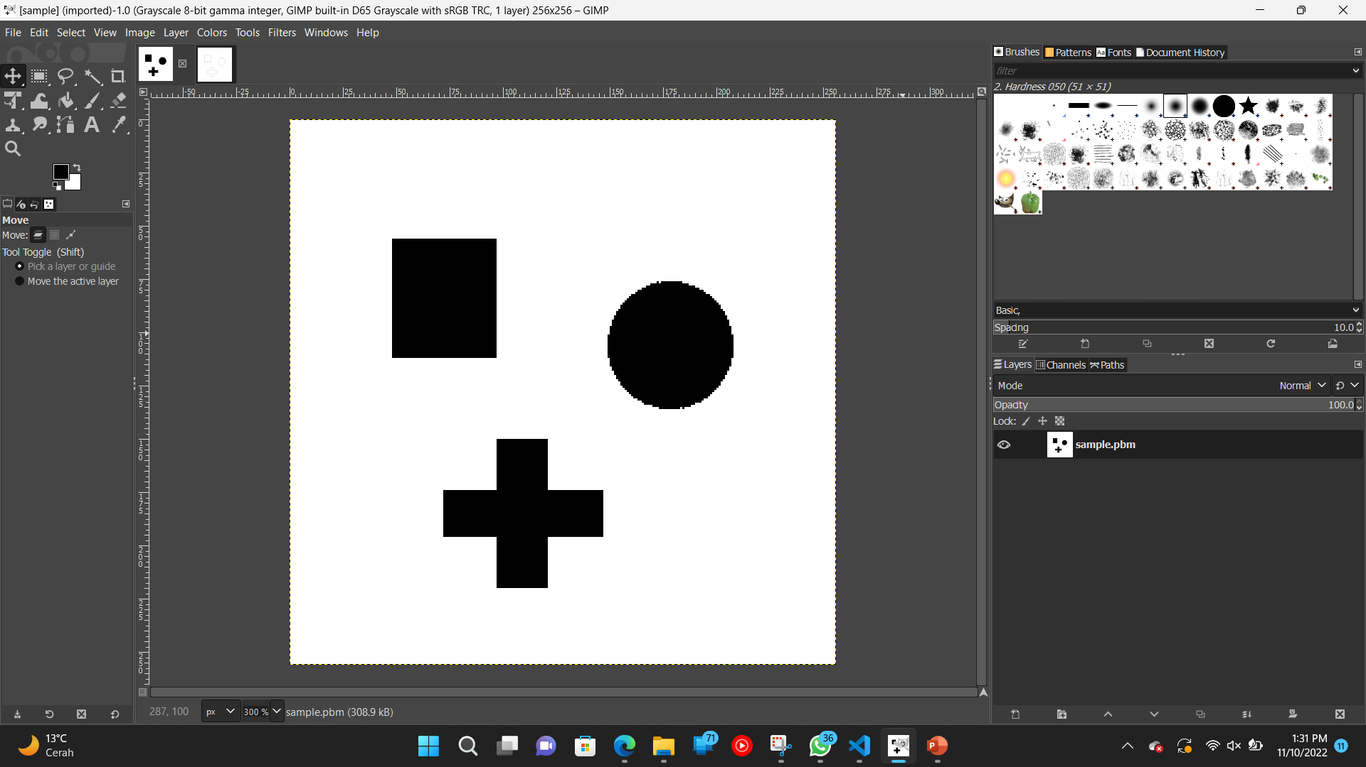
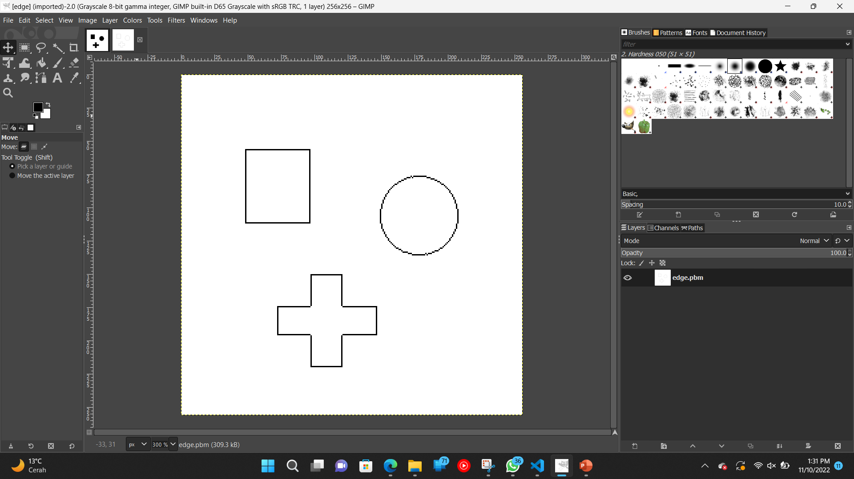
Name : Muhammad Daffa Khairi
ID : 2246176007
Exercise A05
Goal
Complete the function “calc_chain_code()“ in chain.c. Apply labeling and contour
detection to binary image “sample.pbm”.
Output
Figure 1. Original Image
Figure 2. Labeling and Contour Detection Result

Slide 2
Code Specification
Filename : chain.c
Specification of Function
Name | calc_chain_code
Arguments | Bitmap* labelIM (Input Binary Image) int label_no (number of label) Bitmap* edgeIM (Output Binary Image)
Return Value | int
Summary | Chain code
Code Algorithm
Algorithm detect_contour
Variables : | x structure of input label image ln number of label y structure of output contour image
Initialize: Set 0 to all pixel of y For each label l in the image If detect pixel of label l by raster-scan then Set current point (cy, cx) to start point (sy, sx) Set 5 to chain code cn Do Do Set target point (ty, tx) to direction cn of current point (cy, cx) If x(ty,tx) is not equal to l then Set next direction (Fig.A) to cn While x(ty,tx) is not equal to l Record chain code cn Set target point (ty, tx) to current point (cy, cx) y(cy, cx) ← 1, ln ← ln + 1 Set next start code (Table A) to cn while current point (cy, cx) is not equal to start point (sy, sx)

Slide 3
Code
chain.c
int calc_chain_code(Bitmap* labelIM, int label_no, Bitmap* edgeIM)
{
/*********************************************/
int chain_code[8][2] = {
{ 0, 1},
{-1, 1},
{-1, 0},
{-1,-1},
{ 0,-1},
{ 1,-1},
{ 1, 0},
{ 1, 1} };
int next_code_no[8] = { 7,7, 1, 1, 3, 3, 5, 5}; /* next start code */
/*********************************************/
int x, y, xx, yy, start_x, start_y;
int code_no, found, code_length;
char code_str[CODE_LENGTH_MAX];
for (y = 0; y < labelIM->height; y++)
for (x = 0; x < labelIM->width; x++)
if (labelIM->map[y * labelIM->width + x] == label_no) goto LABEL_FOUND;
LABEL_FOUND:
start_x = x;
start_y = y;
code_no = 5;
code_length = 0;
do {
found = 0;
do {
xx = x + chain_code[code_no][1];
yy = y + chain_code[code_no][0];
if ((xx >= 0 && xx < labelIM->width && yy >= 0 && yy < labelIM->height) && labelIM->map[yy * labelIM->width + xx] == label_no)
found = 1;
else {
code_no++;
if (code_no > 7) code_no = 0;
}
} while (found == 0);
sprintf(&code_str[code_length], "%d", code_no);
code_length++;
x = xx;
y = yy;
edgeIM->map[y * edgeIM->width + x] = 1;
code_no = next_code_no[code_no];
} while (!(x == start_x && y == start_y));
printf("(%d,%d) %s\n", start_x, start_y, code_str);
return code_length;
}

